Slide 1
ns-3 Training
ns-3 Annual Meeting
June 2016

Slide 2
ns-3 training goals
Make attendees more productive with ns-3
Learn about the project scope, and where to get additional help
Understand the architecture and design goals of the software
Introduce how to write new code for the simulator
Learn about selected topics in more detail
Answer your questions

Slide 3
Monday agenda
Project overview
Software and usage overview
Waf build system
software core and architecture
nodes, stacks, devices
packets
objects
tracing
debugging
visualization

Slide 4
Tuesday agenda
09:00-10:30: Large-scale, distributed simulations with ns-3 (instructor: Peter Barnes)
10:45-12:15: An introduction to the Direct Code Execution (DCE) environment (instructors: Tom Henderson and Hajime Tazaki)
3:30-15:30: A survey of the LTE models, including model architecture, propagation models, LTE Radio Protocol Stack and EPC model. (instructors: Biljana Bojovic and Lorenza Giupponi)
15:45-17:45: Advanced wireless communications (Wi-Fi, LTE/Wi-Fi coexistence) (instructors: Henderson, Bojovic, Giupponi)

Slide 5
Later in the week
WNS3 Wednesday and Thursday morning
ns-3 Consortium Annual Meeting (2pm Thursday)
Workshop on Wireless Network Performance Evaluation (WNPE) on Friday

Slide 6
Your feedback on requested topics
generating TCP traffic
using TCP instead of UDP in examples
general guidelines on hooking trace sources
general guidelines on implementing protocols
how to pass information from ns-3 to a Python script (sockets?)
HLA-based federation
Underwater Acoustic Networks (UAN)
Configuring 802.11n and ac

Slide 7
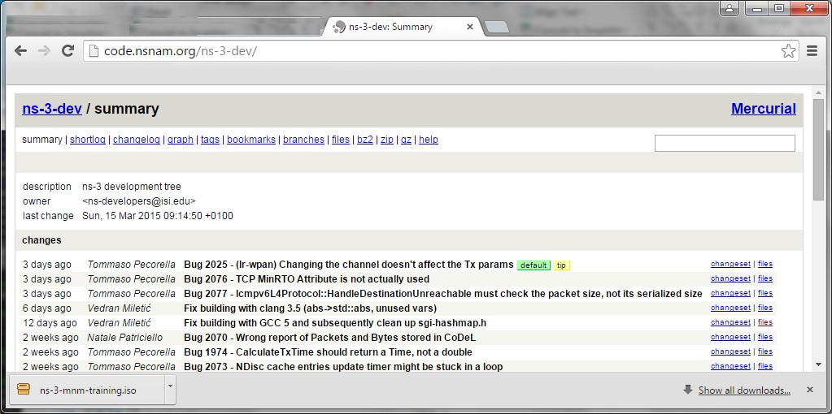
Options for working along
1) Download the required packages onto your (Linux, OS X, or BSD) system
2) Download or copy the ISO image (Live DVD)
3) Browse the code online: https://code.nsnam.org

Slide 8
Project overview

Slide 9
Motivations for ns-3 project
Develop an extensible simulation environment for networking research
1) a tool aligned with the experimentation needs of modern networking research
2) a tool that elevates the technical rigor of network simulation practice
3) an open-source project that encourages community contribution, peer review, and long-term maintenance and validation of the software
Community-maintained, scientific computing software
by following best current practices for open source

Slide 10


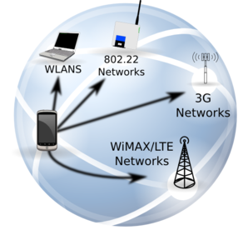




ns-3: An Open Source Network Simulator
ns-3 is a discrete-event network simulator targeted for research and educational use
model developers
Research
ns-3 software
NS-3 Consortium
ns-3 maintainers
Education

Slide 11
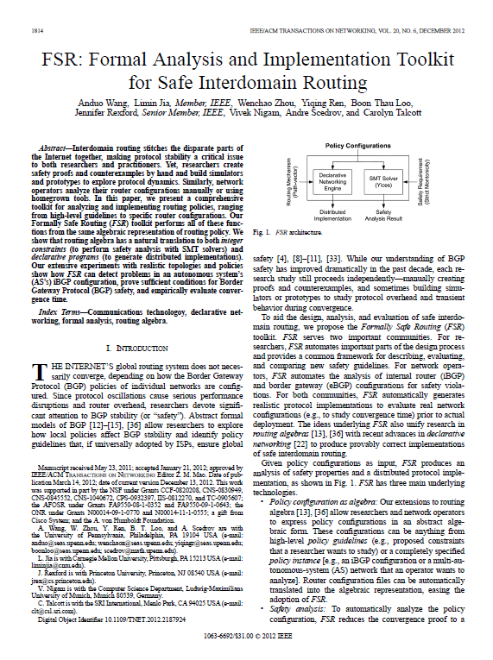
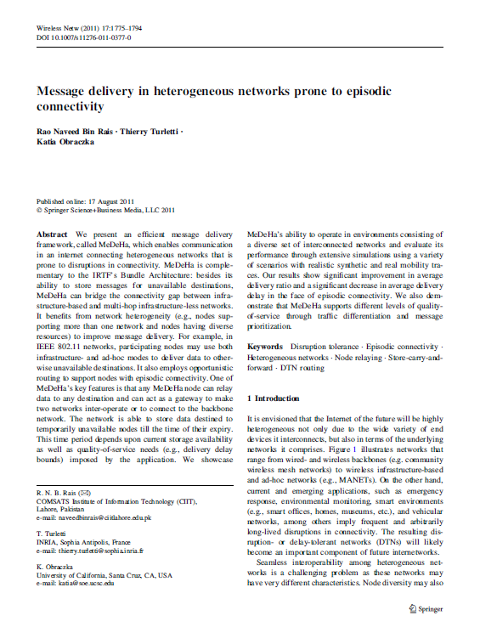
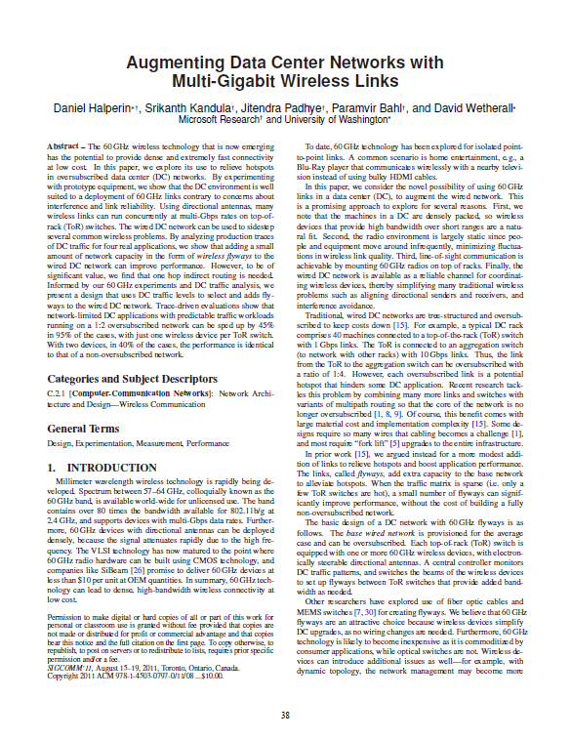
What have people done with ns-3?
thousands of publications to date
search of 'ns-3 simulator' on IEEE and ACM digital libraries, or Google Scholar

Slide 12
How many ns-3 publications?
Google Scholar search of keyword 'ns-3 simulator'
Advanced search filters: English only, excluding patents and citations, custom date range
Results by year (searched May 2016):

Slide 13
Publications using ns-3
A common question is "How many ns-3 papers are there on <insert topic>?
Small survey of 139 paper results from 2013-14 search of IEEE library (top relevant results)
Some papers matched multiple categories
Hot topics:
LTE/cellular networks (15)
Wireless routing protocols (14)
Sensor networks (13)
Wireless MAC and PHY protocols (11)

Slide 14
Paper counts by topic

Slide 15
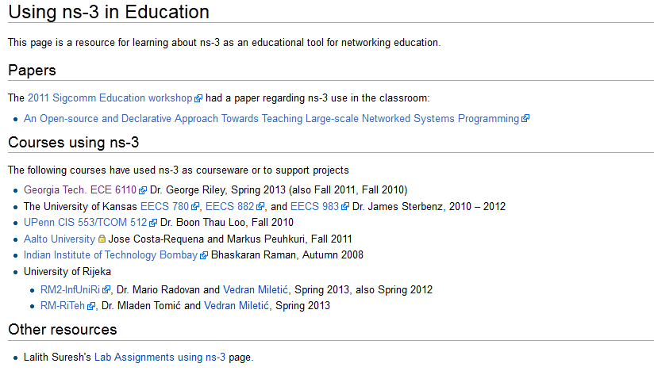
What have people done with ns-3?
Educational use (from ns-3 wiki)

Slide 16
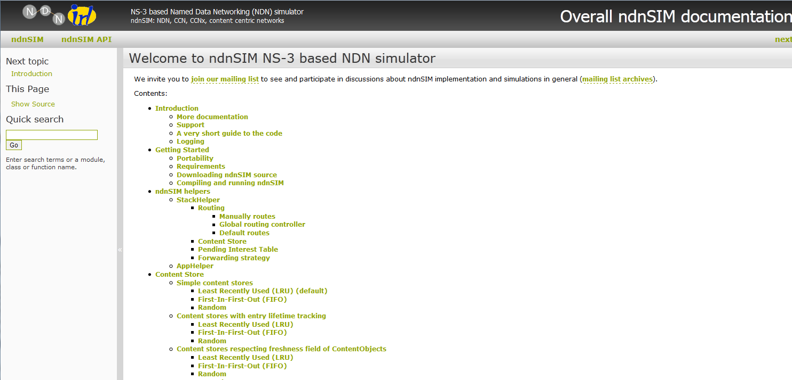
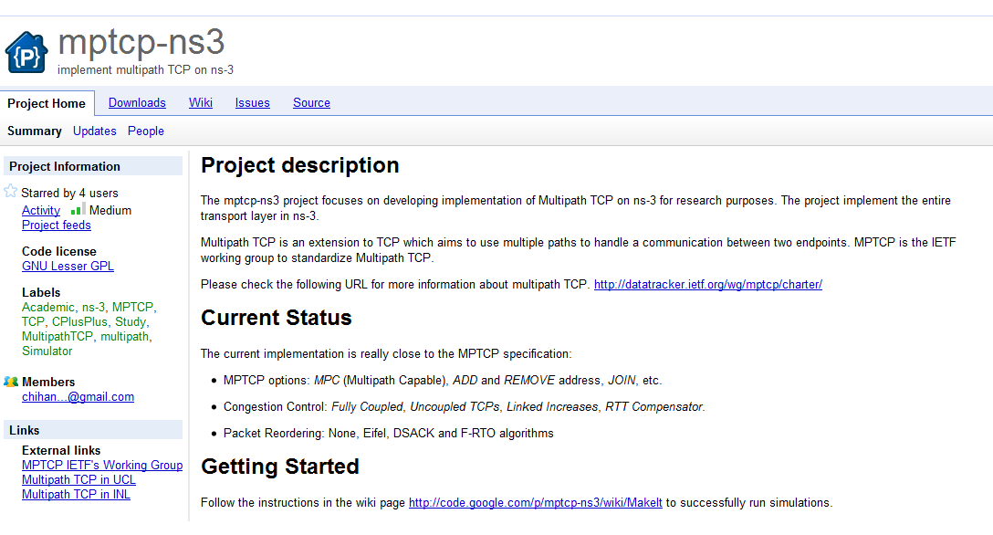
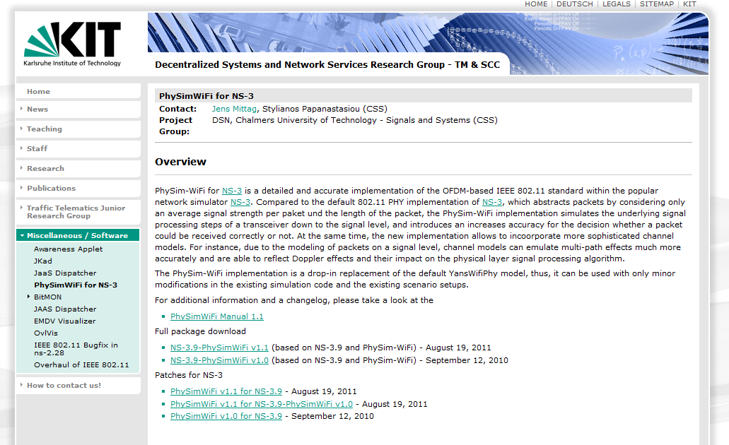
Contributed code and associated projects

Slide 17
ns history
1990
2000
2010
1988: REAL (Keshav)
1990s: ns-1
regular
releases
1996: ns-2
1997-2000: DARPA VINT
2001-04: DARPA SAMAN, NSF CONSER
2006: NSF CISE CRI Awards
Inputs: yans,
GTNetS, ns-2
ns-3 core development (2006-08)
June 2008: ns-3.1
March 2016: ns-3.25

Slide 18
Relationship to ns-2
ns-3 is a new simulator, without backward compatibility
Similarities to ns-2:
C++ software core
GNU GPLv2 licensing
ported ns-2 models: random variables, error models, OLSR, Calendar Queue scheduler
Differences:
Python scripting (or C++ programs) replaces OTcl
most of the core rewritten
new animators, configuration tools, etc. are in work
ns-2 is no longer actively maintained/supported

Slide 19
ns-3 summary characteristics
High performance
core and modular
architecture
Extensions to
reuse real code
Tuesday session 2
Extensions to
run distributed
simulations
Ability to interact
with testbeds in an
emulation mode
Tuesday session 1

Slide 20
Network performance evaluation options
ns-3 enables researchers to more easily move between simulations, test beds, and experiments
Direct Code
Execution
Emulation
modes
ns-3 core
Test and evaluation options
Pure
simulation
Simulation
cradles
Virtual/Physical
test beds
Field
experiments
Live
networks
Increasing realism
Increasing complexity

Slide 21
The open-source project

Slide 22
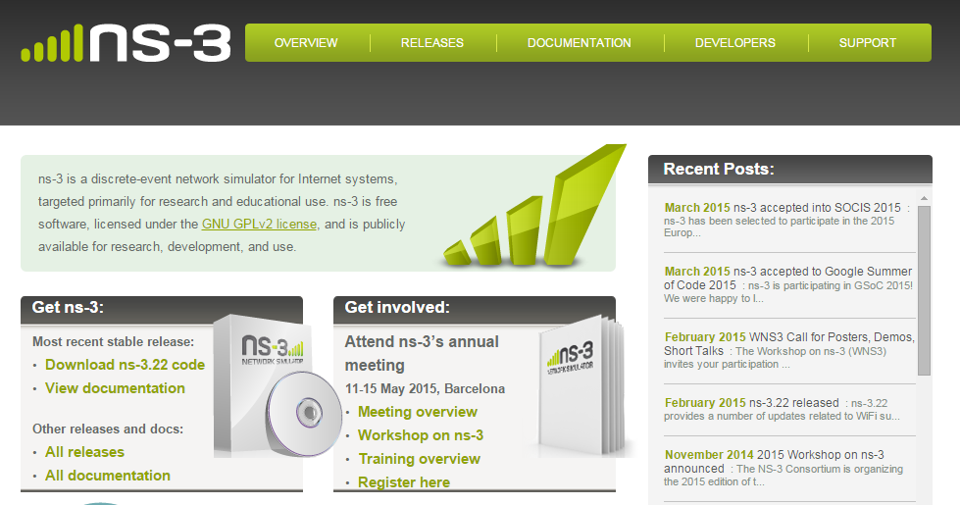
ns-3 main website
Project home: https://www.nsnam.org

Slide 23
How the project operates
Project provides three annual software releases
Users interact on mailing lists and using Bugzilla bug tracker
Code may be proposed for merge
Code reviews occur on a Google site
Maintainers (one for each module) fix or delegate bugs, participate in reviews
Project has been conducting annual workshop and developer meeting around SIMUTools through 2013
Some additional meetings on ad hoc basis
Summer projects (Google Summer of Code, ESA Summer of Code in Space, others...)

Slide 24
Maintainers, Authors, Users
~10-15 maintainers at any given time
191 authors credited in AUTHORS file
Over 6000 subscribers to ns-3-users Google Groups forum
Over 1500 subscribers to ns-developers mailing list
Various project forks exist (on Github and elsewhere)

Slide 25
Sustainment
The NS-3 Consortium is a collection of organizations cooperating to support and develop the ns-3 software.
It operates in support of the open source project
by providing a point of contact between industrial members and ns-3 developers,
by sponsoring events in support of ns-3 such as users' days and workshops,
by guaranteeing maintenance support for ns-3's core, and
by supporting administrative activities necessary to conduct a large open source project.

Slide 26
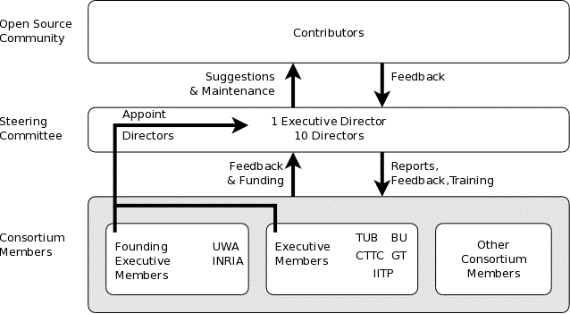
ns-3 Consortium governance
INESC

Slide 27











Acknowledgment of support

Slide 28
Software overview

Slide 29
Software overview
ns-3 is written in C++, with bindings available for Python
simulation programs are C++ executables or Python programs
~350,000 lines of C++ (cloc estimate)
almost exclusively C++98, beginning to use C++11
ns-3 is a GNU GPLv2-licensed project
ns-3 is mainly supported for Linux, OS X, and FreeBSD
Windows Visual Studio port available
ns-3 is not backwards-compatible with ns-2

Slide 30
Discrete-event simulation basics
Simulation time moves in discrete jumps from event to event
C++ functions schedule events to occur at specific simulation times
A simulation scheduler orders the event execution
Simulation::Run() executes a single-threaded event list
Simulation stops at specific time or when events end
Execute a function
(may generate additional events)
Virtual time
Advance the virtual time
to the next event (function)

Slide 31
The basic ns-3 architecture
Application
Application
Application
Application
Sockets-like
API
Protocol
stack
Protocol
stack
Packet(s)‏
Node
Node
NetDevice
NetDevice
NetDevice
Channel
NetDevice
Channel

Slide 32
Software orientation
Key differences from other network simulators:
1) Command-line, Unix orientation
vs. Integrated Development Environment (IDE)
2) Simulations and models written directly in C++ and Python
vs. a domain-specific simulation language

Slide 33
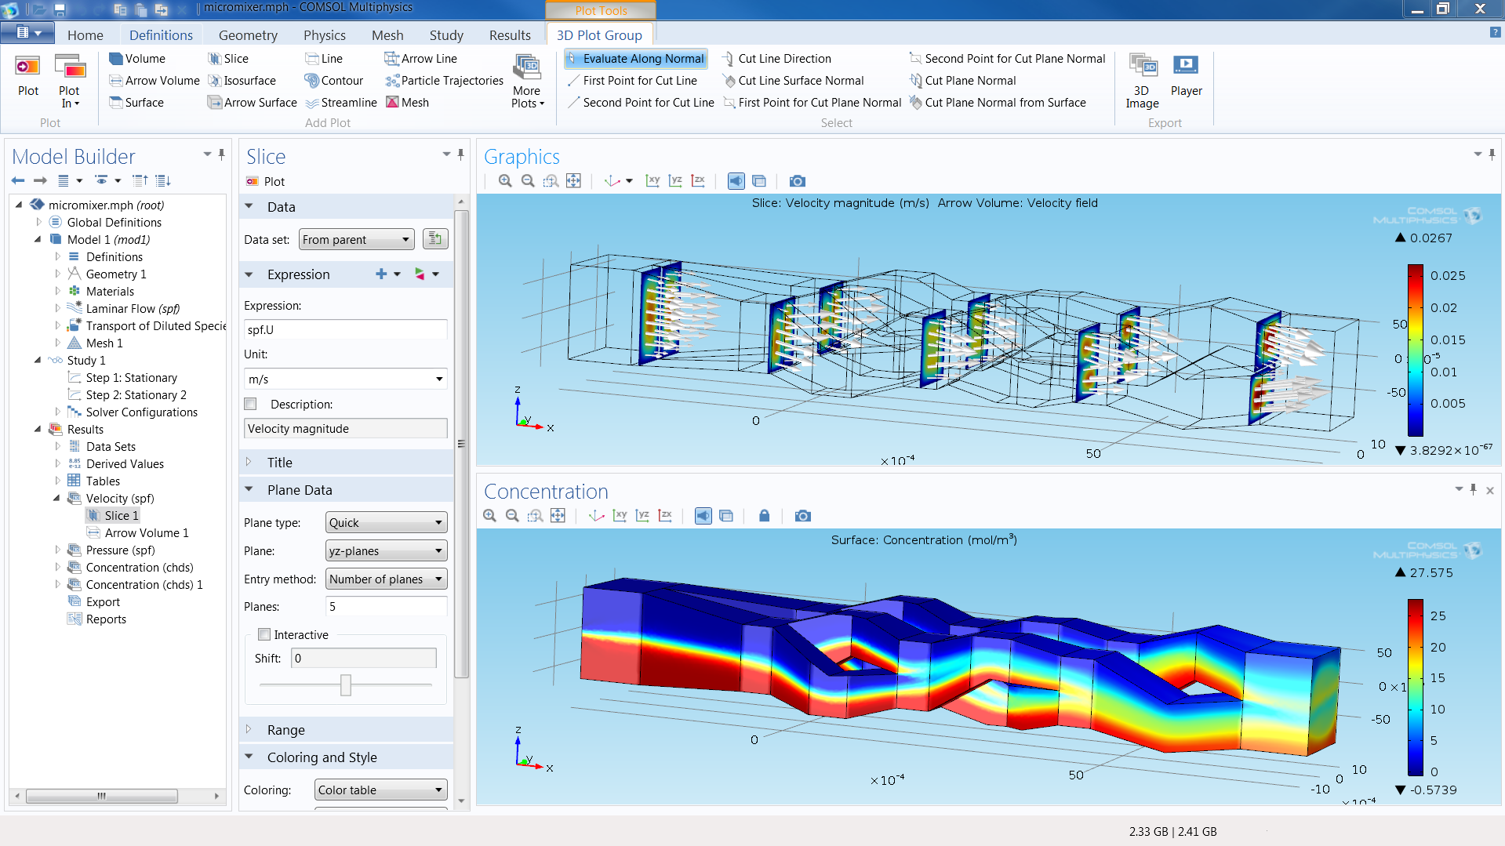
ns-3 does not have a graphical IDE
Figure source: https://www.comsol.com/comsol-multiphysics

Slide 34
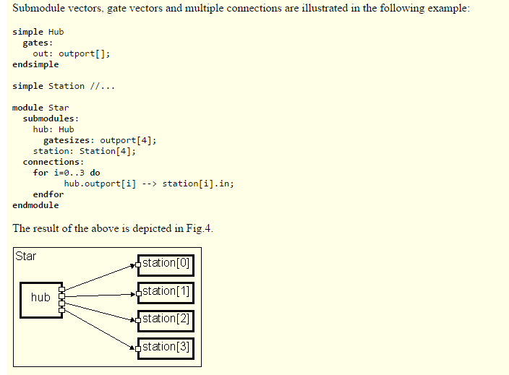
ns-3 not written in a high-level language
Example of OMNeT++ Network Description (NED) language
Figure excerpted from http://www.ewh.ieee.org/soc/es/Nov1999/18/ned.htm

Slide 35
Software organization
Two levels of ns-3 software and libraries
1) Several supporting libraries, not system-installed, can be in parallel to ns-3
Netanim
pybindgen
Click routing
ns-3
2) ns-3 modules exist
within the ns-3 directory
module
module
module
module
module
module

Slide 36
Current models
utilities
devices
protocols
visualizer
bridge
mesh
config-
store
applications
internet-apps
aodv
Node class
NetDevice ABC
Address types
(Ipv4, MAC, etc.)
Queues
Socket ABC
Ipv4 ABCs
Packet sockets
csma
spectrum
internet
(IPv4/v6)
dsdv
flow-monitor
energy
emu
Packets
Packet Tags
Packet Headers
Pcap/ascii file writing
tap-bridge
traffic-control
olsr
netanim
mpi
point-to-
point
uan
click
stats
Smart pointers
Dynamic types
Attributes
Callbacks
Tracing
Logging
Random Variables
mobility
virtual-
net-device
network
nix-vector-
routing
topology-
read
lte
Events
Scheduler
Time arithmetic
propagation
lr-wpan
wifi
core
openflow
BRITE
wimax
36

Slide 37
Module organization
models/
examples/
tests/
bindings/
doc/
wscript

Slide 38
ns-3 programs
ns-3 programs are C++ executables that link the needed shared libraries
or Python programs that import the needed modules
The ns-3 build tool, called 'waf', can be used to run programs
waf will place headers, object files, libraries, and executables in a 'build' directory

Slide 39
Python bindings
ns-3 uses a program called PyBindGen to generate Python bindings for all libraries
v
v
v
v
C++
header
Intermediate
Python
program
C++
bindings
code
Python
module
(py)gccxml
PyBindGen
C++ compiler

Slide 40
Integrating other tools and libraries

Slide 41
Other libraries
more sophisticated scenarios and models typically leverage other libraries
ns-3 main distribution uses optional libraries (libxml2, gsl, mysql) but care is taken to avoid strict build dependencies
the 'bake' tool (described later) helps to manage library dependencies
users are free to write their own Makefiles or wscripts to do something special

Slide 42
Gnuplot
src/tools/gnuplot.{cc,h}
C++ wrapper around gnuplot
classes:
Gnuplot
GnuplotDataset
Gnuplot2dDataset, Gnuplot2dFunction
Gnuplot3dDataset, Gnuplot3dFunction

Slide 43
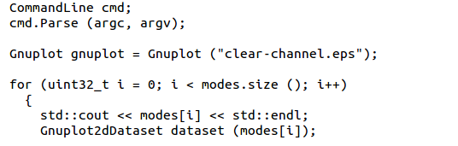

Enabling gnuplot for your code
examples/wireless/wifi-clear-channel-cmu.cc
produce a plot file that
will generate an EPS figure
one dataset per mode
Add data to dataset
Add dataset to plot

Slide 44
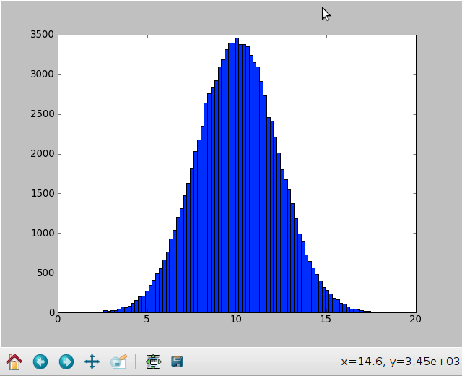
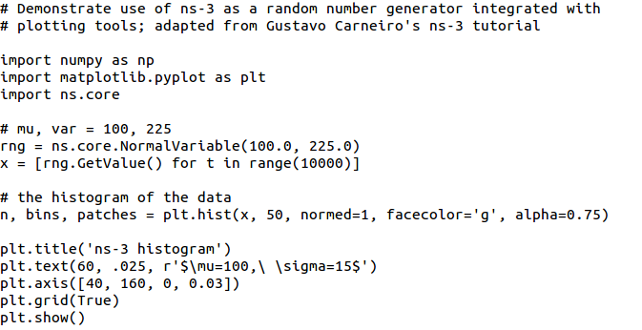
Matplotlib
src/core/examples/sample-rng-plot.py

Slide 45
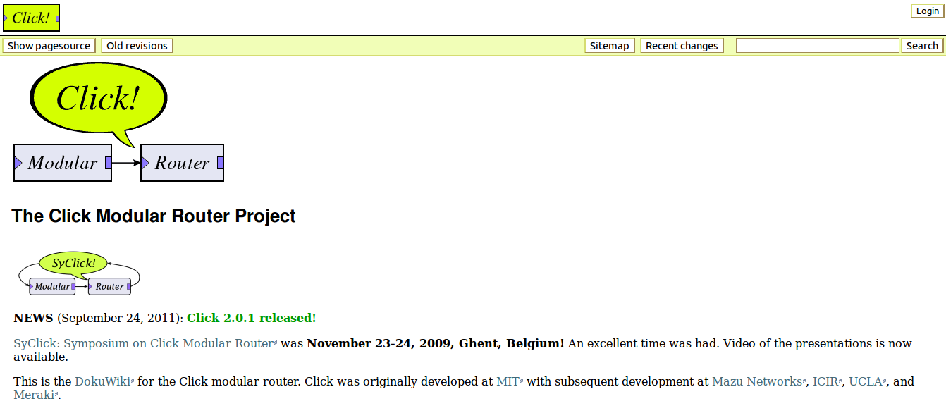
Click Modular Router

Slide 46
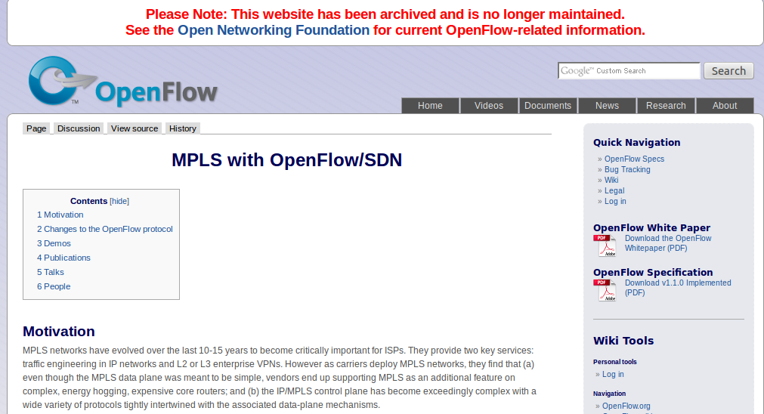
OpenFlow Switch

Slide 47
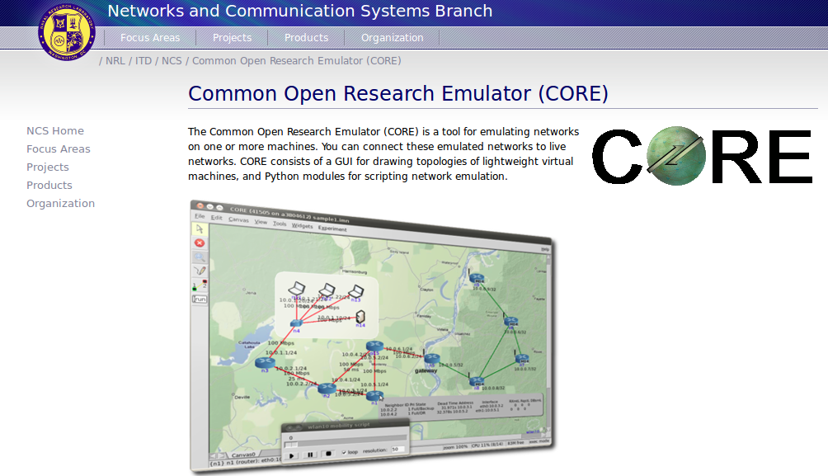
CORE emulator

Slide 48
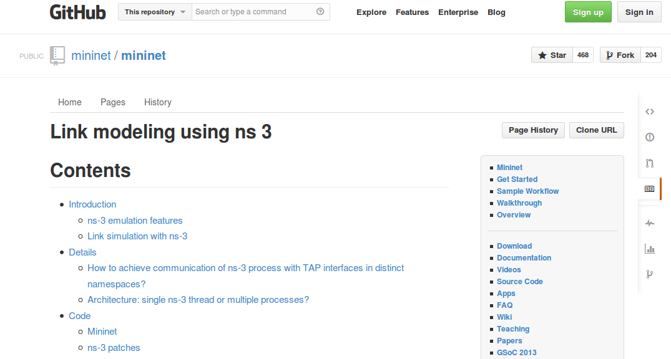
mininet emulator

Slide 49
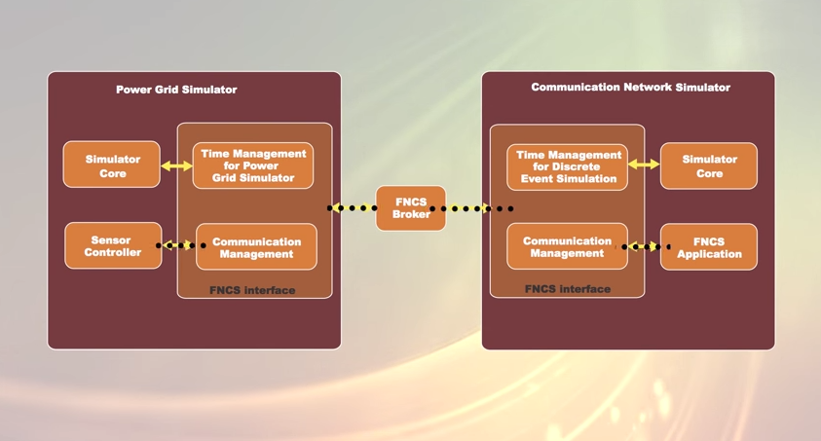
Co-simulation frameworks have emerged
PNNL's FNCS framework integrates ns-3 with transmission and distribution simulators
Image source: PNNLgov YouTube video:
Introducing FNCS: Framework for Network Co-Simulation

Slide 50
FAQs
Does ns-3 have a Windows version?
Yes, for Visual Studio 2012
http://www.nsnam.org/wiki/Ns-3_on_Visual_Studio_2012
Does ns-3 support Eclipse or other IDEs?
Instructions have been contributed by users
http://www.nsnam.org/wiki/HOWTO_configure_Eclipse_with_ns-3
Is ns-3 provided in Linux or OS X package systems (e.g. Debian packages)?
Not officially, but some package maintainers exist
Does ns-3 support NRL protolib applications?
Not yet

Slide 51
Summarizing
ns-3 models are written in C++ and compiled into libraries
Python bindings are optionally created
ns-3 programs are C++ executables or Python programs that call the ns-3 public API and can call other libraries
ns-3 is oriented towards the command-line
ns-3 uses no domain specific language
ns-3 is not compatible with ns-2

Slide 52
Finding documentation and code

Slide 53
Resources
Web site:
http://www.nsnam.org
Mailing lists:
https://groups.google.com/forum/#!forum/ns-3-users
http://mailman.isi.edu/mailman/listinfo/ns-developers
Wiki:
http://www.nsnam.org/wiki/
Tutorial:
http://www.nsnam.org/docs/tutorial/tutorial.html
IRC: #ns-3 at freenode.net

Slide 54
Suggested steps
Work through the ns-3 tutorial
Browse the source code and other project documentation
manual, model library, Doxygen, wiki
ns-3 Consortium tutorials (May 2014)
https://www.nsnam.org/consortium/activities/training/
Ask on ns-3-users mailing list if you still have questions
We try to answer most questions

Slide 55
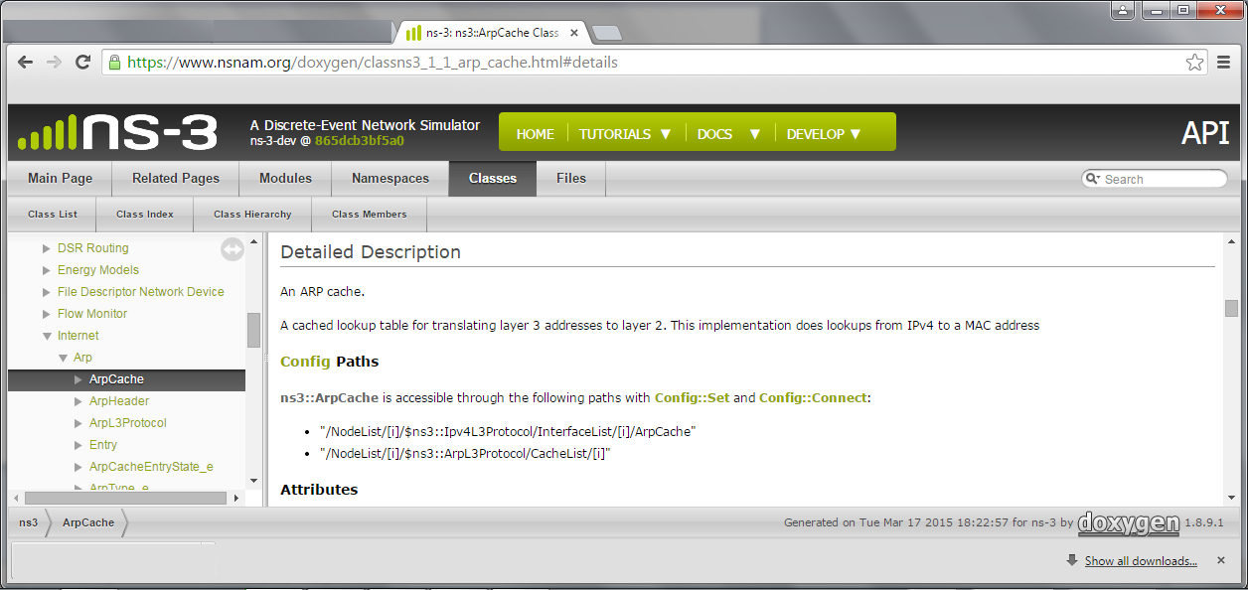
APIs
Most of the ns-3 API is documented with Doxygen
https://www.nsnam.org/doxygen

Slide 56
Contributed code and associated projects

Slide 57
Reading existing code
Much insight can be gained from reading ns-3 examples and tests, and running them yourselves
Several core features of ns-3 are only demonstrated in the core test suite (src/core/test)
Stepping through code with a debugger is informative
callbacks and templates make it more challenging than usual
'find src -name "*.h" | xargs grep "string..." '

Slide 58
Review
ns-3 primarily aims to support the networking researcher
ns-3 is C++ under GPLv2, with Python bindings
ns-3 is mainly designed for low-level coding, work at the command line, and composition with other tools
most users edit or extend the source code
ns-3 tries to operate according to open source project best current practices
everyone is a volunteer
search for what you need, ask questions when you get stuck, and think about contributing back to the project

